Slide 1
PREMIER SOCCER PREDICTOR
Group : 11
Harsh Pithadia
Vinit Bhanushali
Monjil Mehta
Eesha Pandit

Slide 2
INTRODUCTION
The "Premier League Match Outcome Predictor Using Machine Learning" project is aimed at leveraging advanced data analysis and machine learning techniques to forecast the results of Premier League football matches. The English Premier League is one of the most widely followed and competitive football leagues globally, making it an ideal subject for predictive modeling. The project seeks to provide fans, sports enthusiasts, and analysts with a data-driven tool that can offer insights into the potential outcomes of these high-stakes matches.

Slide 3
Problem Statement
Predicting the outcomes of Premier League soccer matches is a multifaceted problem that involves analyzing historical data, team-specific information, and various factors influencing the performance of football teams. This project seeks to address this problem by developing a machine learning model capable of accurately forecasting the results of Premier League matches, specifically categorizing them as wins, losses, or draws. Within this overarching challenge, we aim to answer specific questions and tackle key problems, including:
1. Match Outcome Prediction
2. Historical Trends
3. Team Performance Evaluation
4. Opponent Analysis
5. Feature Importance
6. Algorithm Selection
7. Data Quality and Missing Values
8. Generalization to Future Matches
9. Model Evaluation
10. Real-World Applications

Slide 4
PLANNING
Week 1: Project Setup and Data Exploration | Day 1-2: Setup Project Environment Day 3-4: Data Collection and Reading Day 5-7: Data Cleaning and Preprocessing
Week 2: Feature Engineering and Initial Model | Day 1-2: Feature Selection Day 3-4: Model Selection and Implementation Day 5-7: Model Evaluation
Week 3: Model Improvement and Retraining | Day 1-2: Rolling Averages Day 3-4: Model Refinement Day 5-7: Retraining
Week 4: Final Model and Conclusion | Day 1-2: Combining Predictions Day 3-4: Final Model Evaluation Day 5-6: Project Conclusion Day 7: Future Work and Documentation

Slide 5
METHODOLOGIES

Slide 6
DATA COLLECTION & FEATURE ENGINEERING
Data Sources:
Data will be collected from reputable sources, including official Premier League records, sports statistics websites, and APIs.
We have ensured data quality and accuracy through data validation processes
Reading Match Data:
We will begin by reading the Premier League match data into a pandas DataFrame.
Data Cleaning:
To ensure the dataset's suitability for machine learning, we will clean the data by addressing inconsistencies, outliers, and data quality issues.
Investigating Missing Data:
We will investigate and handle missing data in the dataset, considering its impact on the model's accuracy.
Creating Predictors
Our predictors will include various features from the dataset, such as team information, opponent details, venue, day, attendance, captain, and formation. These features will serve as essential inputs for our machine learning model.
Data Update Frequency:
Planning for regular updates as new data becomes available to adapt to changing team dynamics.

Slide 7
MODEL
Why Decision Tree Algorithm?
Decision Trees provide a straightforward, interpretable model for predicting match results and help visualize the influence of different features.
Their simplicity is advantageous for feature selection and understanding key attributes, but they can be prone to overfitting.
Why Random Forest Algorithm?
We plan to employ machine learning algorithms, specifically focusing on the Random Forest algorithm for classification, using Python. Random Forest combines multiple decision trees to predict Premier League match results, reducing overfitting and improving accuracy.

Slide 8
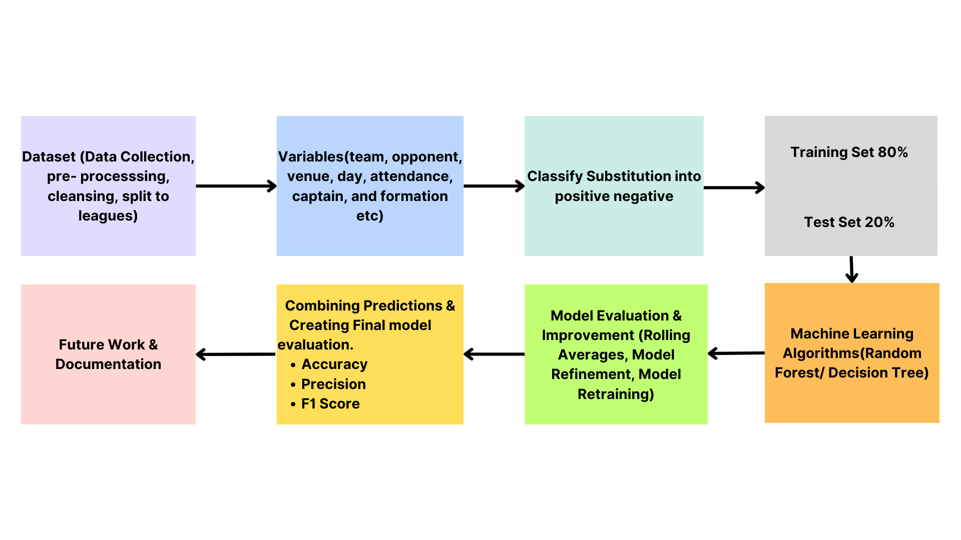

Slide 9




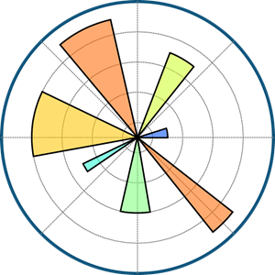




TOOL & TECHNOLOGIES

Slide 10
CONCLUSION
In conclusion, By addressing these questions and problems, our project endeavors to contribute to the field of sports analytics, providing valuable insights and predictive capabilities that extend beyond mere historical analysis. It seeks to improve our understanding of the factors influencing soccer match results and offers practical applications within the context of the Premier League.

Slide 11
THANK YOU

